Slide 1
TRA STAKEHOLDER UPDATE
Tim Maurer, Executive Director
September 29, 2026
Notes:
This presentation attempts to answer the following:
Where is TRA positioned today?
How did we get here?
Where are we going?
How do our status and trends compare to other public pension plans?

Slide 2

OUR MISSION
TRA provides retirement, disability, and survivor benefits to Minnesota’s public educators assisting them in achieving future income security. TRA strives to provide benefits that attract and retain competent teachers who serve communities throughout the state, building a stronger education system. TRA is committed to safeguarding the financial integrity of the fund and takes pride in providing exceptional, innovative services.

Slide 3
MEMBERSHIP STATISTICS
107
Oldest Retiree’s Age
75
Number of
Retirees Aged 100+
67 years
Longest-Receiving
Beneficiary
(as of June 30, 2026)

Slide 4

BASIC RETIREMENT FUNDING FORMULA
Contributions
Benefit Expenses
C + I = B + E
Investment Income
Expenses
“Money In = Money Out”

Slide 5
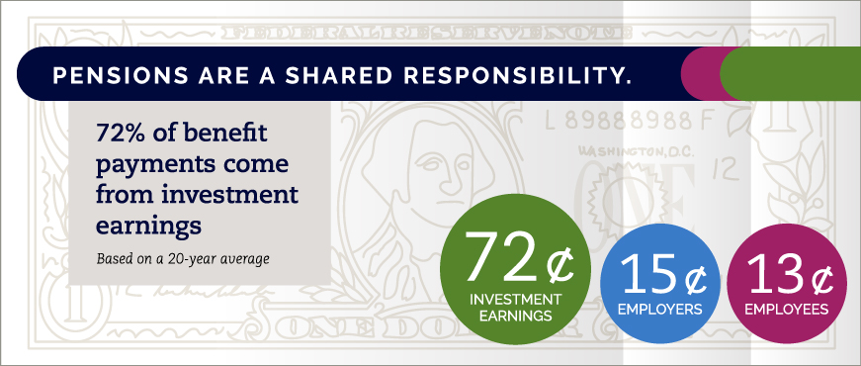
PENSION FUNDING
Payroll contributions and investment earnings pre-fund benefits.
Professional actuaries monitor the fund through annual valuations and quadrennial experience studies.
Assets are managed professionally by the Minnesota State Board of Investment (SBI).

Slide 6
GENERAL FUNDING APPROACH
Normal Cost
Amortization of the Unfunded Actuarial Accrued Liability (UAAL)
Expenses (if not embedded elsewhere)
The sum of these is often called the Actuarially Determined Contribution.

Slide 7
Estimated Actuarial status
ACTUARIAL VALUE OF ASSETS BASIS – JULY 1, 2026
$ in Billions, Contributions as % of pay | July 1, 2025 | July 1, 2026
Actuarial Accrued Liability | 37.0 | 38.1
Asset Value | 30.2 | 31.8
Unfunded Actuarial Accrued Liability (UAAL) | 6.8 | 6.3
Funded Ratio | 81.6% | 83.4%
Normal Cost (with expenses) | 11.64% | 11.64%
Amortization of UAAL | 6.41% | 5.74%
Total Required Contribution | 18.05% | 17.38%
Member plus Employer Contributions | 18.49% | 18.47%
Contribution Surplus/(Deficiency) | 0.44% | 1.09%
Note: Numbers may not add due to rounding.

Slide 8
Estimated Actuarial status (CONTINUED)
MARKET VALUE OF ASSETS BASIS – JULY 1, 2026
$ in Billions, Contributions as % of pay | July 1, 2025 | July 1, 2026
Actuarial Accrued Liability | 37.0 | 38.1
Asset Value | 31.3 | 35.2
Unfunded Actuarial Accrued Liability (UAAL) | 5.7 | 2.9
Funded Ratio | 84.5% | 92.2%
Normal Cost (with expenses) | 11.64% | 11.64%
Amortization of UAAL | 5.26% | 1.49%
Total Required Contribution | 16.90% | 13.13%
Member plus Employer Contributions | 18.49% | 18.47%
Contribution Surplus/(Deficiency) | 1.59% | 5.34%
Note: Numbers may not add due to rounding.

Slide 9
Funding Projections and Sensitivity
Funded Ratio
If the investment return during FYE 2027 is 0% and 7.0% thereafter, the funded ratio is projected to be 100% in 2039.
If the investment return during FYE 2027 is -10% and 7.0% thereafter, the funded ratio is projected to be 100% in 2055.
Note: The funded ratio uses the actuarial value of assets.

Slide 10
Impact of 2023–2025 Legislative Changes
% of Unreduced Benefit
Age at Retirement:
Age at Retirement: | 60 | 61 | 62 | 63 | 64 | 65
Factor Change: | 28.95% | 25.04% | 7.38% | 5.88% | 4.55% | 3.20%

Slide 11
Impact of 2025 Benefit Change
Calculations assume a No Refund benefit for a person with a $75,000 high-five average salary, 10 years of service at a 1.7% multiplier, and 20 years of service at 1.9%.
*NRA = Normal Retirement Age
Age | 60 | 61 | 62 | 63 | 64 | 65
62-and-30 with NRA 66 | $1,993.75 | $2,234.38 | $2,939.06 | $3,080.00 | $3,207.19 | $3,327.50
62-and-30 with NRA 65 | $2,234.38 | $2,475.00 | $3,080.14 | $3,209.22 | $3,328.19 | $3,437.50
60-and-30 with Augmented 5% Factors | $2,988.77 | $3,095.16 | $3,192.82 | $3,282.16 | $3,363.59 | $3,437.50

Slide 12
Postretirement increase
2027 postretirement adjustment:*
1.4%
*for eligible individuals
TRA’s postretirement increases are scheduled to increase by 0.1% through 2028 and then remain at 1.5%.
Year | 2018 | 2019 | 2020 | 2021 | 2022 | 2023 | 2024 | 2025 | 2026 | 2027
Adjustment | 2.0% | 1.0% | 1.0% | 1.0% | 1.0% | 1.0% | 2.5% | 1.2% | 1.3% | 1.4%

Slide 13
2026 UPDATE
Legislative Session
The 2027 legislative session will begin January 12, 2027. It must conclude by May 17, 2027.
2027 Board of Trustees Election
The TRA trustee election process is underway to fill two active member seats on the board.
Key milestones:
  October 2026 – Candidacy applications available on minnesotatra.org
  December 11, 2026 – Candidacy filing deadline
  January 2027 – Candidates announced
  Early Spring 2027 – Voting (active members only)
  Late Spring 2027 – Election results announced
  July 1, 2027 – Elected trustees’ terms begin

Slide 14
Strategic Planning
The TRA Board of Trustees engaged Mosaic Governance Advisors for its strategic planning project this year.
Initially, Mosaic will focus on stakeholder engagement and research.
  This involves stakeholder surveys open during October.
  Mosaic invites TRA members, retirees, and beneficiaries to share their feedback.
  TRA is promoting survey participation through its communications. Please share and participate!
Visit minnesotatra.org this
October to take the
SURVEY

Slide 15
THANK YOU
Questions?

